Slide 1
Mobile Sales Dashboard Overview
Interactive Dashboard for Business Insights
SRIAPTHI VENAKTA SIVAMNIKANTA
27 April 2025

Slide 2
Objective
Goal: Create an interactive dashboard for mobile sales KPIs.
Tools: Power BI
Outcome: Help stakeholders make informed decisions.

Slide 3
Dataset Overview
Source: Kaggle (Mobile Sales Dataset)
Data Points: Product ID, Brand, Model
Sales Units, Revenue, Profit
Region, Date, Discounts, Growth Rate

Slide 4
Chosen KPIs
📈 Total Sales Revenue
💰 Total Profit
🔥 Sales Growth Rate
📱 Top-Selling Brands/Models
🌍 Regional Sales Distribution

Slide 5
Dashboard Features
Interactivity: Slicers (Date, Region, Brand), Filters
Visualizations: Line Charts, Bar Charts, Cards for KPIs
Extras: Consistent Color Theme, Navigation Buttons

Slide 6
Sample Dashboard Layout
Top: KPI Cards (Sales, Profit, Growth)
Left: Filters (Date, Region, Brand)
Center: Sales Trend Line Chart
Bottom: Bar Chart of Top Brands

Slide 7
Insights & Recommendations
Insight 1: Brand X highest sales in Q4.
Insight 2: Region Y declining trend - needs focus.
Insight 3: Premium models = high margins.
Recommendation: Market premium models more.

Slide 8
Conclusion
Interactive dashboards = real-time performance tracking.
Better visibility leads to better decisions!
Future: Add predictive sales analytics.

Slide 9
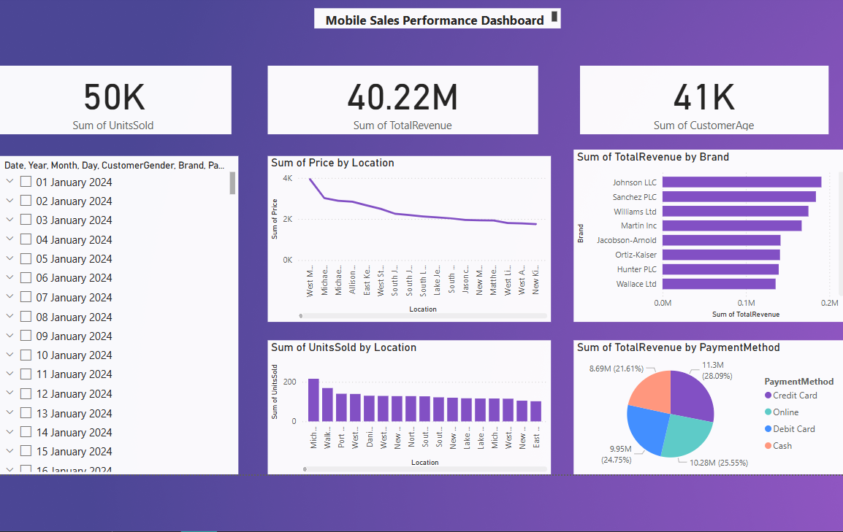

Slide 10


